Slide 1
Assignment on Different Connections in Tableau
Submitted By: POORAN PRAGNYA
NOVEMBER BATCH (BDS)

Slide 2
Different connections in tableau
Working with file Vs Servers in Tableau:
Tableau can be connected to different types of files like MS Excel, text file, JSON file, PDF file etc.
Tableau can also be connected to data server like SQL Server, MYSQL Server, Oracle Server, Amazon Redshift Server and then select the database table and columns to work with.

Slide 3
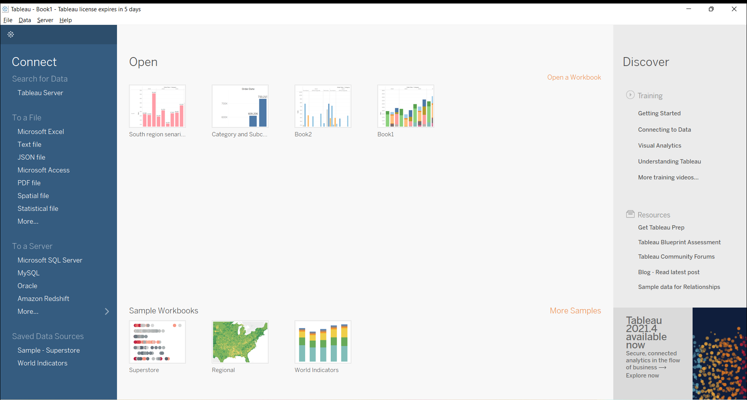


Slide 4
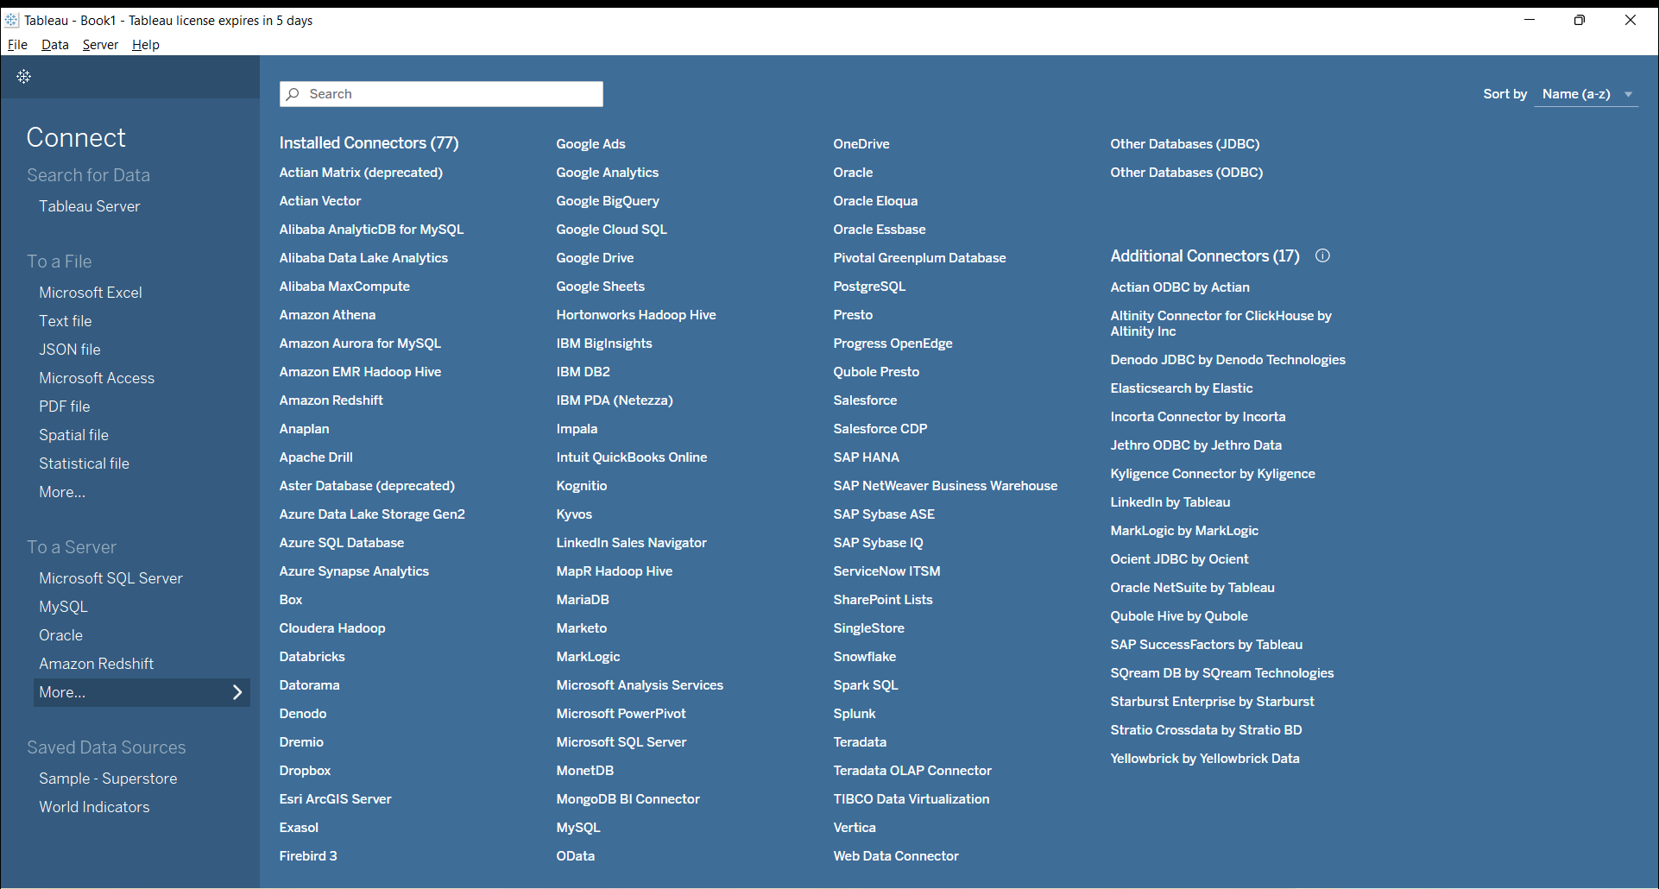

Slide 5
Different data connectivity options in tableau
It supports 2 types of connectivity options:
Live
Extract

Slide 6
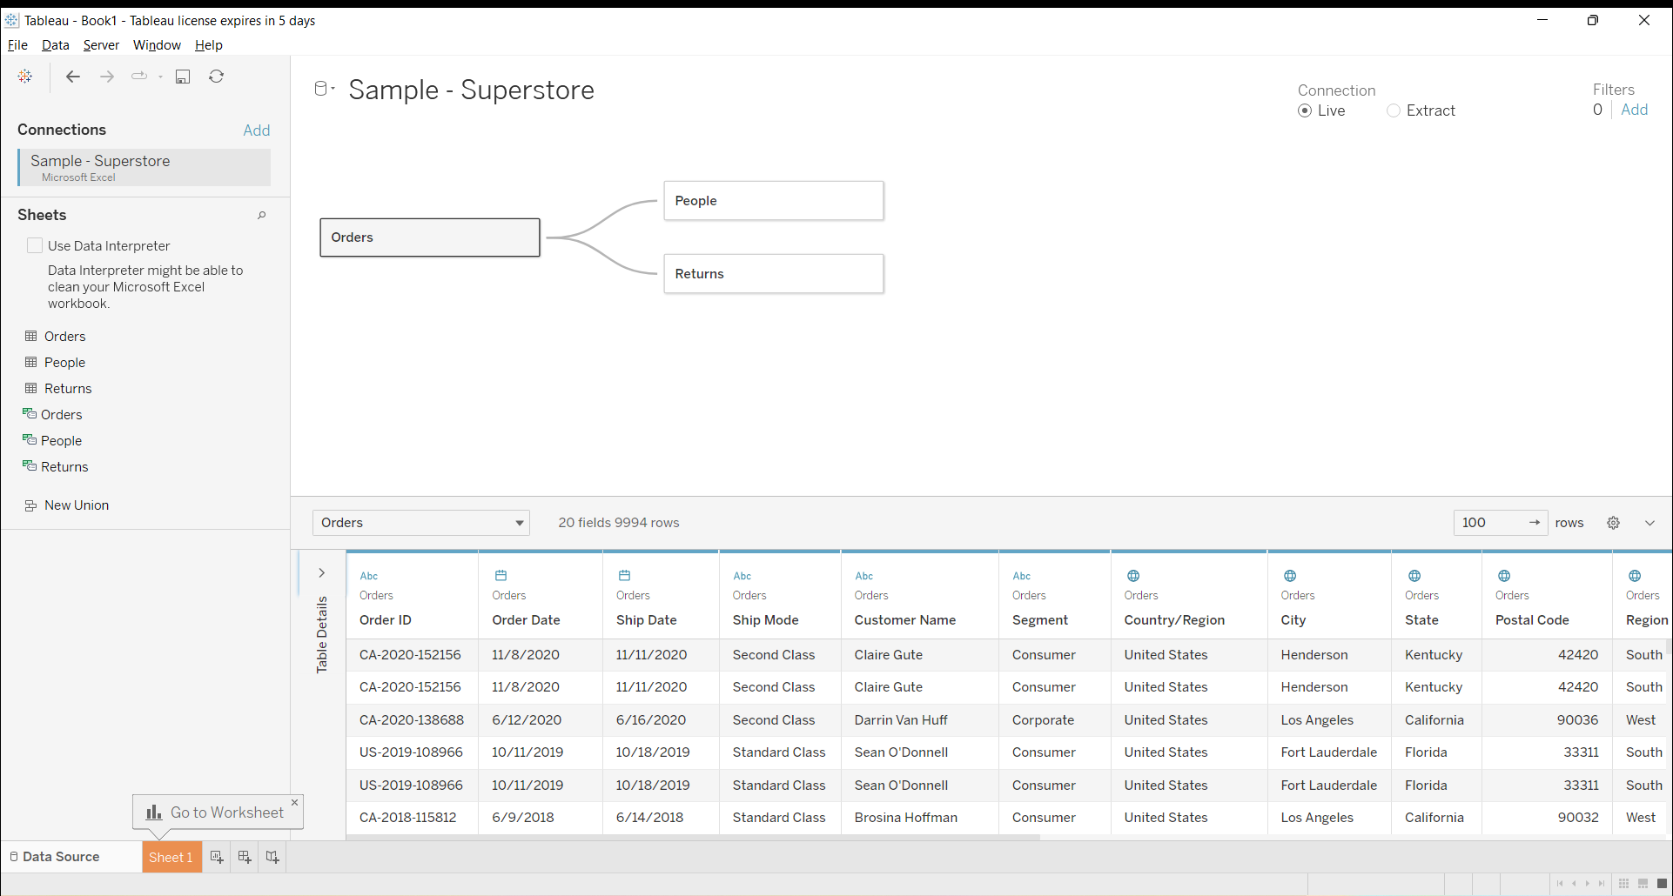



Slide 7
1. Live connection
Under this, we connect to that particular dataset and work on that particular dynamic (which updates every minute/hour/day) dataset from our tableau desktop.
It is generally used when dataset is too large and which cannot be copied into local system and work on that

Slide 8
2. EXTRACT CONNECTION
Extract is basically copying that particular dataset in our local system and working on that particular dataset from tableau desktop.
For extract connection we have the ability to copy that data and work around that data and working around on reports and dashboards.

Slide 9
Live Connection | Extract Connection
It is a connections to the data sources that are directly linked to a database and relies on it for all the query processing and also undergoes real time updates too | It is a snapshots of data organized for segregation/clustering these snapshots load directly into Tableau’s memory for faster query processing for data visualization.
It is slower than extracts | It is faster than live connections.
There is dependence of internet here | There is no such dependency of internet here.
It is recommended when working with a faster database | It is recommended when working with small or slower database
There is no such privacy here | It provides a privacy so that people see only the data you need them to
In this, we will not miss out on the latest updates to the data | Here, we may miss out on the latest updates to the data.

Slide 10
Tableau Public | Tableau Desktop
It is a free version of Tableau Desktop | It is a paid version
It has very limited data connectivity options | It can connect to hundreds of data sources including Big data connections like Hadoop.
It doesn’t support ‘Live Connection’ to any data sources i.e all the data sources used in the Tableau Public are ‘Extract Connection’ by default. | It supports both Live as well as Extract Connections
It is not possible to save the workbook created on Tableau public locally on our system ( it can only be saved to Tableau Public Server/Gallery) | Here, we can save the workbook created in our local system

